Slide 1
Logistic Regression

Slide 2
What is Logistic Regression?
Learning
A supervised algorithm that learns to separate training samples into two categories
Logistic regression is a statistical model used to predict the probability of a binary outcome based on one or more independent variables.
It is a type of regression analysis where the dependent variable is categorical, typically representing two classes (e.g., yes/no, true/false, 0/1).
Prediction
Uses the learned line, plane or hyper-plane to predict the whether an input sample results in a target of 0 or 1 (yes/no, true/false)

Slide 3
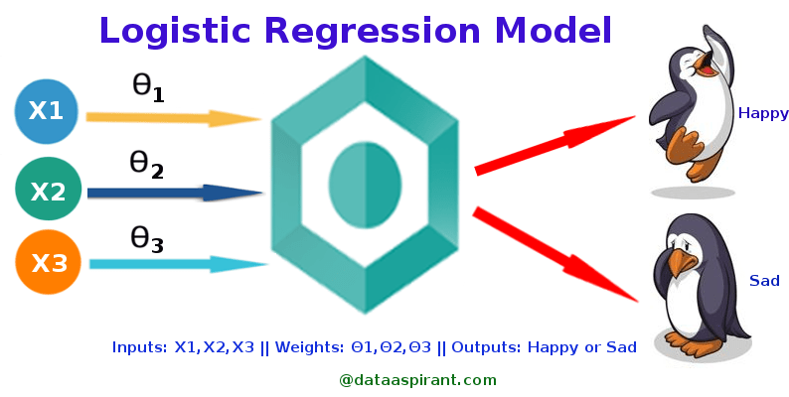
Logistic Regression is used when the dependent variable(target) is categorical.
For example, To predict whether an email is spam (1) or (0) Whether the tumor is malignant (1) or not (0)

Slide 4
_{Y =} ⎧Non − smoker
Categorical Response Variables
Whether or not a person
⎨Smoker
⎩
^{smokes} Binary Response
_{Y =} ⎧Survives
Success of a medical treatment
Opinion poll responses
⎩
⎧Agree
⎨Dies
Y = ⎮Neutral
Ordinal Response
⎨
⎮Disagree
⎩

Slide 5
The main goal of logistic regression is to find the relationship between the independent variables and the probability of the binary outcome.
It estimates the probability using a logistic function, also known as the sigmoid function, which maps any real-valued number to a value between 0 and 1.

Slide 6
Unlike, linear regression, which is used to make a prediction on the numeric response , Logistic Regression is used to solve a classification problem.
For example, when a person applies a loan from a bank, bank is interested in predicting whether the applicant will default in future.
Due to the nature of the problem, the prediction will fall in [0,1].

Slide 7
By the rule of thumb, if the prob. is greater than equal to 0.5, then we can label the applicant as default.
Range of Linear regression is -∞ to +∞, however range of logistic regression is 0 to 1.

Slide 8
Types of Logistic Regression
Binary Logistic regression
Multinomial Logistic Regression 3.Ordinal Logistic Regression

Slide 9
Hypothesis Representation
When using linear regression we used a formula of the hypothesis i.e. h_{Θ}(x) = β₀ + β₁X
For logistic regression we are going to modify it a little bit i.e. σ(Z) = σ(β₀ + β₁X)
We have expected that our hypothesis will give values between 0 and 1.

Slide 10
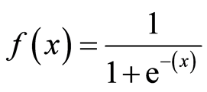
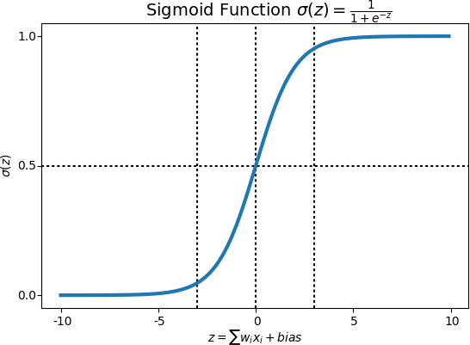

Sigmoid function
Logistic Regression

Slide 11
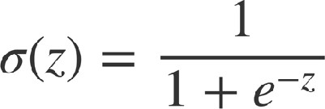
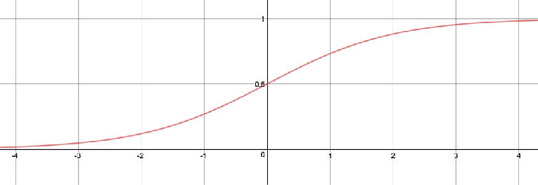
Logistic Regression
The outcome probability is modeled using the logistic function, also known as the sigmoid function.
Here's the logistic function:
And has a graph like this:
By applying this function we end up with predictions that are between zero and one

Slide 12
In logistic regression, the goal is to find the best-fitting line (or hyperplane in higher dimensions) that separates the two classes in the feature space.
The logistic function is used to transform the output of a linear combination of input features into a probability score between 0 and 1.
This probability represents the likelihood that the input belongs to one of the two classes.
The formula for logistic regression can be represented as:

Slide 13
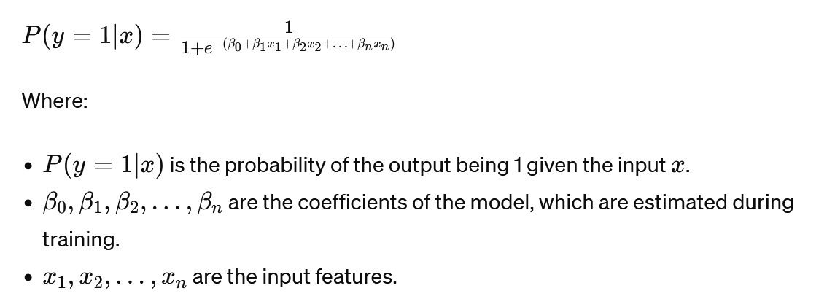

Slide 14
During training, the logistic regression model learns the optimal values for the coefficients (β) that best fit the training data. This is typically done using optimization algorithms like gradient descent, which minimize a cost function such as the cross-entropy loss.
Once trained, the logistic regression model can predict the probability of new instances belonging to one of the two classes, and based on a chosen threshold (often 0.5), it can make binary predictions.

Slide 15
Decision Boundary
We expect our classifier to give us a set of outputs or classes based on probability when we pass the inputs through a prediction function and returns a probability score between 0 and 1.
For Example, We have 2 classes, let’s take them like cats and dogs (1 — dog
, 0 — cats).
We basically decide with a threshold value above which we classify values into Class 1 and of the value goes below the threshold then we classify it in Class 2.

Slide 16
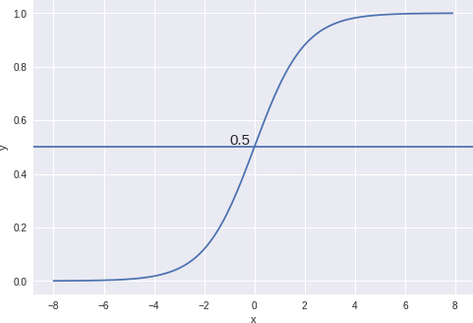
As shown in the above graph we have chosen the threshold as 0.5, if the prediction function returned a value of 0.7 then we would classify this observation as Class 1 (DOG).
If our prediction returned a value of 0.2 then we would classify the observation as Class 2(CAT).

